Slide 1
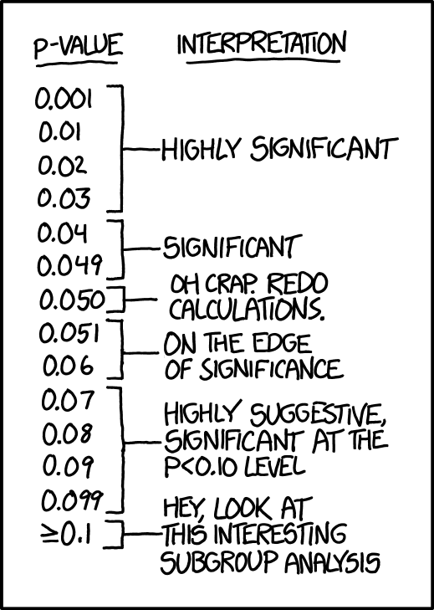
Image Source

Slide 2
Welcome to Week 15, Lecture 02!
Hypothesis Testing with Python

Slide 3
Agenda
Assignments & Announcements
Belt Exam Eligibility & Reminders
Selecting the Right Hypothesis Test
Stating the Hypothesis.
Selecting the correct test for the question/type of data.
Checking the assumptions of the selected test.
Determine the final test to run after checking assumptions.
Perform and interpret the statistical test

Slide 4
Assignments
This week’s assignments:
Project 3 Part 3(Core)
Describing Distributions (Core)
Hypothesis Testing with Insurance Data(Core)
Remember that Belt Exam eligibility is this Friday at 9AM
Make sure you have all of week 1 and 2 assignments submitted and any resubmits from week 1.
Note that content from this week (week 3 of the stack) is assessed on the exam!

Slide 5
📣 Announcements
Alumni Onboarding Info Session:
Next Thursday 05/12/22 @ 4:30 PM PST (During pre-lecture office hours)
Sarah Lee Catli, our Alumni Community Development Manager will be joining us to discuss all of the great benefits our alumni receive post-graduation.
Bonus Lecture Next Week:
Please answer the following poll on the topic and time slot for a bonus lecture next week: https://forms.gle/bUxX4rznSEkpgaPR9
I will check tomorrow morning to determine the winner.
It is completely optional.
It will be recorded.

Slide 6
Belt Exam

Slide 7
Belt Exam Eligibility
Final deadline for Belt Exam eligibility is Friday 05/06 (tomorrow) at 9 AM PST.
Requirements:
All week 13 and week 14 assignments submitted.
All week 13 resubmits corrected.
It is YOUR responsibility to check your feedback doc for resubmission requests.
No more than 1 missed lecture.
If you have a Friday one on one:
DO NOT UNLOCK YOUR EXAM BEFORE WE MEET!!!

Slide 8
Important Belt Exam Reminders
Do NOT use a Public repository for your belt exam!!!
When you publish your repo, keep the “Keep Code Private” box checked!
If you accidentally make it Public, change it to Private IMMEDIATELY!
See this help article for how to change the visibility after publishing
Use a private repository, commit and push your final work to GitHub, and then follow the instructions on the next slide to download a zip file of your private repo to turn in as your final submission.
Your repo/zip file should contain:
a jupyter notebook (.ipynb file) with your work
a .sql file of your exported database. (Instructions for exporting database from mysql workbench: https://login.codingdojo.com/m/376/12528/88194)
If anything goes wrong when submitting your belt exam, IMMEDIATELY email me your zip file as a backup. jirving@codingdojo.com
Email submissions sent more than 24 hours after you unlock your exam will not be graded.

Slide 9
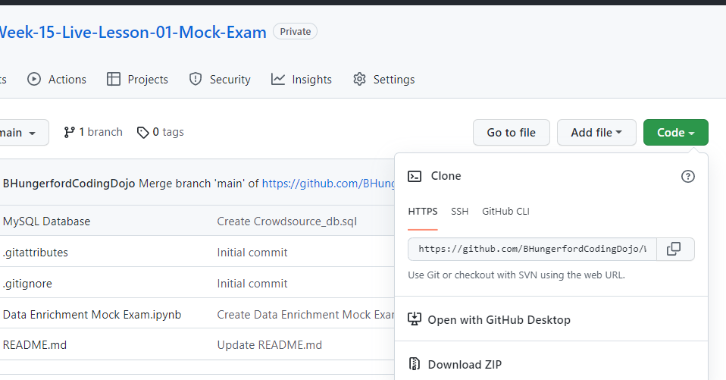
How to Download your final repository as a zip file on github.com

Slide 10
MOCK BELT EXAM SOLUTION
Solution Repository:
Note: the solution is A solution and is not the only way of accomplishing the mock belt exam’s task. There are several ways of doing some of the steps and I tried to demonstrate some of them as different "approaches" - indicated in the headers.
Solution Repository: https://github.com/coding-dojo-data-science/data-enrichment-mock-belt-exam

Slide 11
Intro to Hypothesis Testing
Review from Last Lecture

Slide 12


Slide 13
Hypothesis Testing: Getting Started
Is there actually a significant difference between two groups or are the differences just due to randomness?
Example:
A survey goes out and asks students to rate Jupyter notebooks and Google Colab each on a scale of 1-5.
On average, Jupyter scores higher, but can we conclude that students really do prefer Jupyter notebooks or is it just due to randomness?

Slide 14
Selecting the Right Test
Everything covered in the next few slides can be found in the:
“Guide: Choosing the Right Hypothesis Test” lesson.

Slide 15
Test Selection Overview
STEP 1: Stating our Hypothesis
STEP 2: Determine the category/type of test based on your data.
Answer 2 questions about what you are comparing to determine which test.
Once you know which test, check the assumptions of the test.
STEP 3: Does the data meet the assumptions of the selected test?
If you meet the assumptions, run the desired test.
If you don’t meet the assumptions, run the non-parametric equivalent test.
STEP 4: Perform Test & Interpret Result
Run the selected statistical test to get your p-value and interpret it.
Do you reject your null hypothesis or did you fail to reject it?
STEP 5: Post-hoc multiple comparison tests (if needed)

Slide 16
STEP 1: Stating our Hypothesis

Slide 17
State the null and alternate hypothesis
Null Hypothesis:
The null hypothesis is the one that seems like it doesn’t need to be stated! It is that there is nothing special going on. In our case:
Null Hypothesis (H₀): There is NO difference between ratings for Jupyter notebooks and Google Colab
Alternate Hypothesis:
The alternate hypothesis is usually what you would just think of as “the” hypothesis! It states that something significant is going on.
Alternate Hypothesis: (H_{a}) There is a significant difference between ratings for Jupyter notebooks and Google Colab

Slide 18
Establish the significance Level (alpha)
The most common significance value is alpha = 0.05.
This means that if the likelihood of the results due to random chance (p) is less than 5%, we consider the results significant (and not just random).
If we use a significance value of 0.01, it means than the likelihood of the results due to randomness (p) must be less than 1% in order for us to claim it is significant.
Setting an alpha value establishes your willingness to accept Type 1 or Type 2 errors, and really it depends on your data and situation. When in doubt, consult a SME!
Examples of Type 1 and 2 Errors with Hypothesis Testing

Slide 19
STEP 2: Determine the category/type of test based on your data.

Slide 20
Test Selection Question 1
Question 1: Is my data Categorical or Numerical?
What type of data is the target of your question?
Are you asking about differences in a measured value or differences in which category/group something belongs to?
Example Numeric:
A company wants to compare the time spent on different versions of their homepage. Does one version make users stay on the page significantly longer?
An instructor expects an exam average to be roughly 85%, and wants to know if the actual scores line up with this expectation. Was the test actually too easy or too hard?
Example Categorical:
A pollster wants to know if men and women have significantly different flavor preferences for ice cream. Does a result where more men more often answer "chocolate" as their favorite reflect a significant difference in the population?
Are men and women equally likely to be smokers?

Slide 21
Test Selection Question 2
Question 2: How many samples/groups am I comparing?
1 Sample (i.e., comparing to an ideal target)
i.e., comparing an actual result against a desired target or Key Performance Indicator (KPI)
2 Samples
i.e., comparing a control and treatment group or an A/B test
More than 2 Samples
i.e., comparing three different variants of a landing page

Slide 22
Select the Right Test Using your Answers
What type of comparison? | Numeric Data | Categorical Data
Sample vs Known Quantity/Target | 1 Sample T-Test | Binomial Test
2 Samples | 2 Sample T-Test | Chi-Square
More than 2 | ANOVA and/or Tukey | Chi-Square

Slide 23
STEP 3: Does the data meet the assumptions of the selected test?

Slide 24
Test Assumptions
Each statistical test was built with specific assumptions about the data.
If we do not meet a test’s assumptions, we cannot trust the result.
For numeric data, the assumptions are usually:
No significant outliers
Normally distributed GROUPS
Equal Variance between groups.
For categorical data, the assumptions are usually:
The outcome is binary (e.g.: two groups, success vs failure)
The trials/observations are independent.
For a list of the assumptions for each test:
See the Choosing the Right Hypothesis Test lesson.

Slide 25
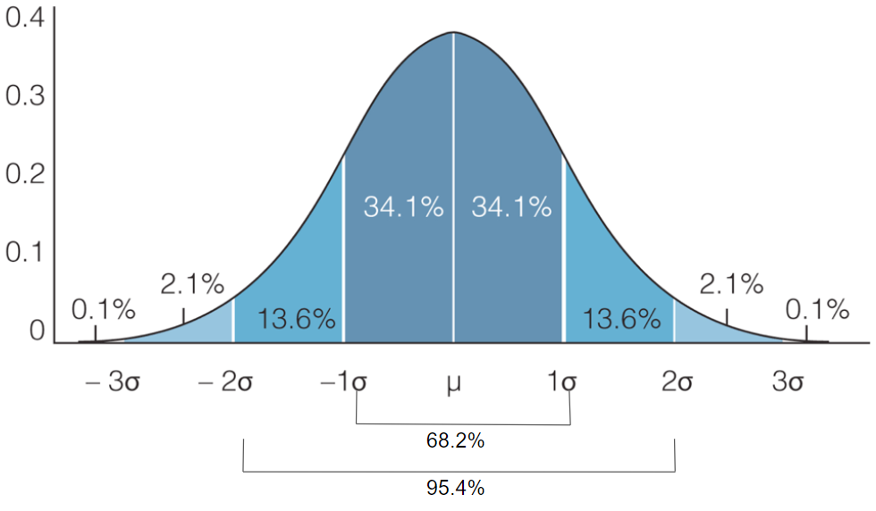
Testing for/Removing Outliers
Z-Score Rule:
Any value that has a z-score more than more than 3 standard deviations away from the mean is considered an outlier.
Outliers must be removed from each group SEPARATELY!
Use scipy.stats.zscore to calculate z-scores.
Any z-score that has an absolute value >3 is an outlier.

Slide 26
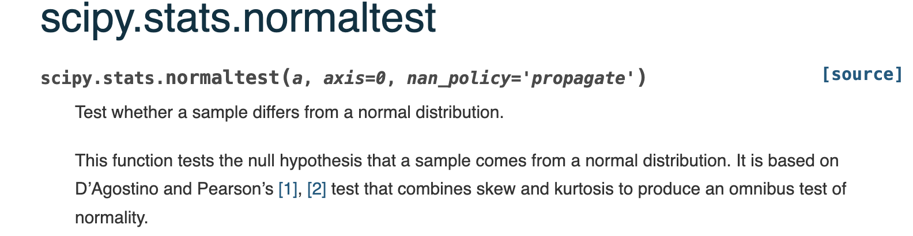
Testing for Normally Distributed Groups - 1
Use a statistical test to check for if groups normally distributed:
D'Agostino-Pearson's normality test: Scipy.stats.normaltest
To interpret the p-value from the normal test you must check the null hypothesis of the normaltest.

Slide 27
Testing for Normally Distributed Groups - 2
However, if your group n’s are large enough, its ok if you do not pass a normaltest.
Parametric Test | Sample size guidelines for non-normal data
1-sample t-test | Greater than 20
2-sample t-test | Each group should be greater than 15
One-Way ANOVA | If have 2-9 groups, each group n >= 15. If have 10-12 groups, each group n>20.

Slide 28
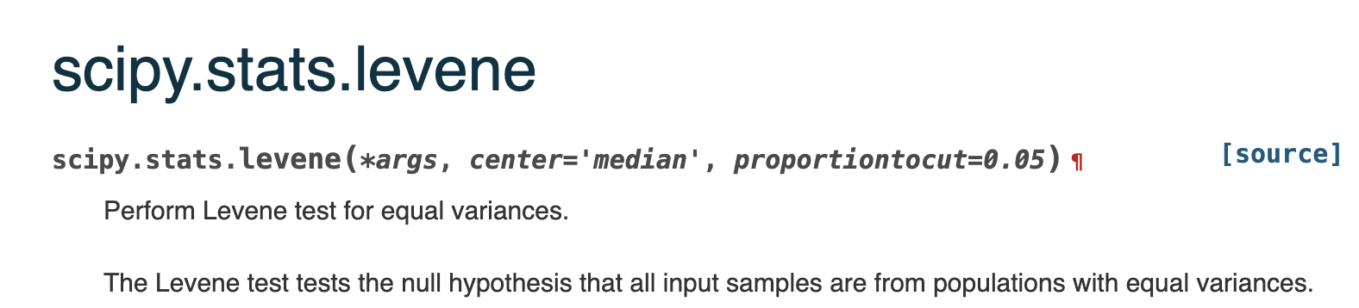
Testing for Equal Variance
Use a statistical test to check for if groups have equal variance:
Levene’s Test: Scipy.stats.levene
To interpret the p-value from Levene’s test you must check the null hypothesis of the test:

Slide 29
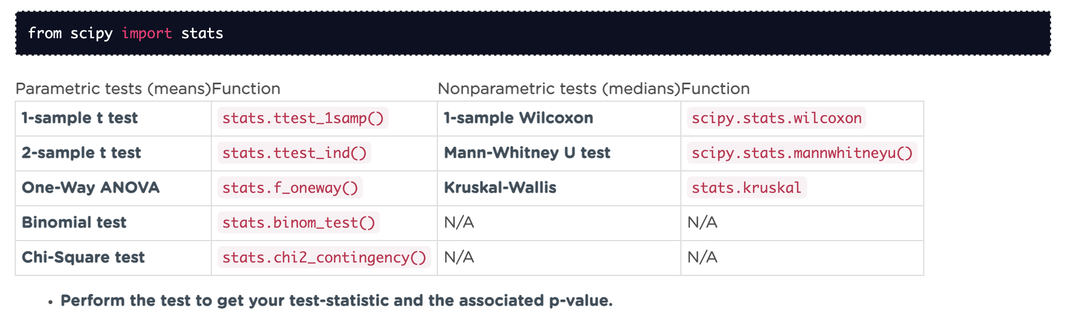
Final Test Selection
Then we select the non-parametric equivalent of our original parametric test.
All functions below are located in the stats module of scipy.
See this cheat sheet for more info on each of them cheatsheet: Hypothesis Testing with Scipy

Slide 30
STEP 4: Perform Test & Interpret Result

Slide 31
Perform Final Test & Interpret
Perform the final test selection after checking assumptions:
See this cheat sheet for more info on using the scipy functions. cheatsheet: Hypothesis Testing with Scipy
Whichever statistical test you use, you will be given a p-value in your results.
The p-value is the probability of your situation occurring due to random chance.
Interpret Your P-Value:
If the p-value is > alpha:
We fail to reject the null hypothesis. There is no significant difference between groups.
If the p-value is < alpha:
Reject the null hypothesis. There is a significant difference between groups. We have supported the alternative hypothesis.
If you have multiple groups (i.e. ANOVA, Kruskal-Wallis), see Step 4: Post-Hoc Tests in order to determine which groups were different.

Slide 32
STEP 5: Post-hoc multiple comparison tests (if needed)

Slide 33
Post-Hoc Tests
When our hypothesis includes more than 2 groups, our p-value indicates there IS a significant difference between groups, but we not WHICH groups.
We must run a pairwise Tukey's test to know which groups were significantly different.
Tukey pairwise comparison test
Statsmodels.stats.multicomp.pairwise_tukeyhsd
Tukey's test will run separate tests on pair of groups to get a separate p-value for each. But it does it in a smart way that prevents false positives.

Slide 34
Activity

Slide 35
Mock Belt Exam - Revisited
We will be revisiting the mock belt exam for our codealong.
https://github.com/coding-dojo-data-science/data-enrichment-hypothesis-testing-codealong
The ETL steps have been completed and we will focus just on the hypothesis testing steps.
If there is time there is a more advanced follow-up hypothesis for us to test, as well.

